Slide 1
CSIA BP&B Webinar Series Module 1 General and Human Resource Management
Notes:
Welcome to Module 1 of the CSIA’s Best Practice and Benchmarks webinar series – Module 1 – General and Human Resource Management

Slide 2
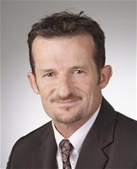
Your Presenter Tom Sulda BEng (Hons), Grad Cert Mgt, Dip PM CSIA Certified BP&B Auditor
Notes:
Hi – I’m Tom Sulda one of the CSIA’s certified global best practice and benchmark auditors

Slide 3
Today’s Presentation Covers……
Section 1 - General Management
Strategic Management
Clarity including its depth of communication and understanding with employees; and
Strategic alignment to Key Performance Indicators or KRA’s
Succession Planning; and
Insurance as a control against business risks
Notes:
Read from slide

Slide 4
Today’s Presentation Covers……
Section 2 - Human Resource Management
Job/Position descriptions
Drug and alcohol policies
Recruitment and selection processes
Employee induction and orientation
Performance management
Training Programs for SI internal systems and processes; including
Safety
Notes:
Read from slide then……..
As a quick aside – each scoreable part of the standard is shown in its entirety on each slide in the deck and I will provide an overview of a each as I go along. If you want to take a closer look and spend some time looking at the slide in more detail – simply pause the presentation.
Please note to save time we are focussing on the scoreable sections – reading the standard in its entirety however does give you a good over view on the wider aspects of best practice for system integrators
And with that comment we I’ll move straight onto Section 1 – Strategic Management

Slide 5
Section 1 – Strategic Management
1.1.1 Is the integrator clear about its purpose, strategic objectives and goals? Does the integrator have a mission, vision statement, and strategic objectives? Does the integrator follow a clear strategic planning process?
• The mission and/or vision statement should be written. The creative act of writing a mission and/or vision statement forces management to evaluate the direction of the business.
• The written mission and/or vision statement should be publicized to all employees. It should be posted or otherwise available to all employees.
• The mission and/or vision statement form the basis and starting point for the business plan.
• Strategic objectives which are in line with the mission and/or vision statement should be developed which can be used for developing tactical business plans.
• Competitive strategies as to how the integrator will compete in the marketplace should be considered
• The business climate, market and industries shift and change over time. A company, therefore, should periodically evaluate the effectiveness and relevance of its management and key positions to meet its organizational requirements.
• The business plan should include an Executive Summary or Statement of Purpose which describes the objective of the business and required resources to achieve the objectives.
• Key areas of the business which should be addressed by the business plan include marketing, sales, operations, finance and personnel development and other items that affect revenue strategy.
• While the business plan is proprietary, all key employees should have access to it and should be aware of its content.
Notes:
To cover off on this section we are really talking about developing an overall strategic plan. Its quite correct that sitting down and generating one does cause you to think about where you are going and what you are actually planning to do (and by when) – and there is a mention in there about tactical plans to achieve the mission. There are quite a few good tools available out there and one in particular that I’ll mention by way of example is the strategy on a page tool. On one side is all the information relating to where you are going as a company and why – the culture you support and your vision. Of real importance is how you plan to get there and that involves setting some key result areas also known as strategic pillars. Against each on the following page you actually set the targets – how you are actually going to measure them and the initiatives (or tactical plans) that underpin their success. What this means is that you don’t need to get too fancy on this and the presence of such a document and the thinking that goes behind generating it does show quite a bit of maturity in this space and a potentially high mark for its presence. Another good thing is that the simplicity and high level nature of this kind of tool can ultimately be shared by employees at all levels. Its also a good idea to find yourselves an experienced facilitator to challenge your thinking and guide to an agreed outcome.
Lets quickly go through this tool…..

Slide 6
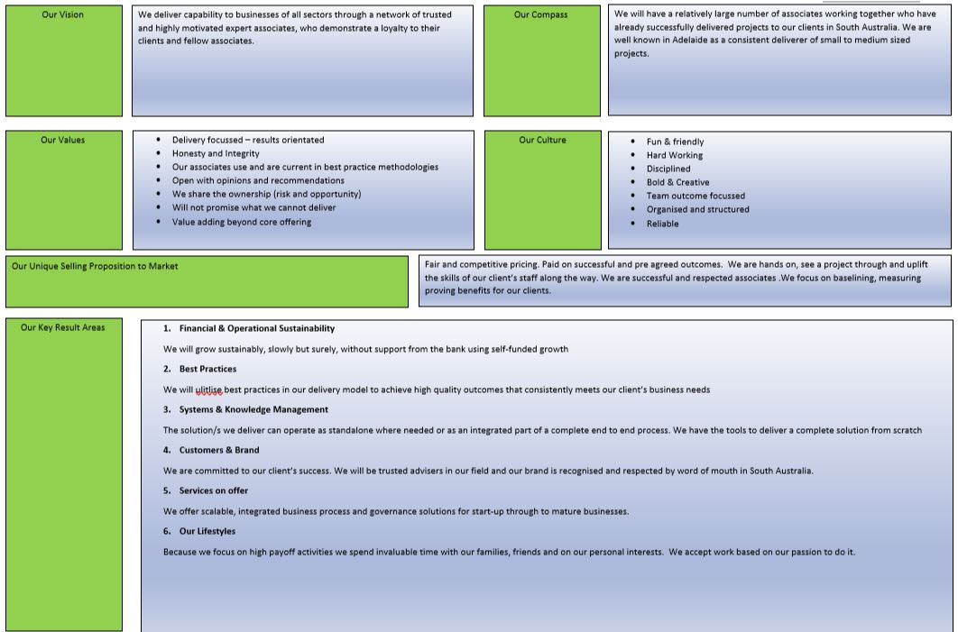
Example – A Balanced Scorecard
Notes:
This is also an example of what is sometimes referred to as a balanced score card
Now - describe verbally
Now turning to the opposite side of the page…….

Slide 7
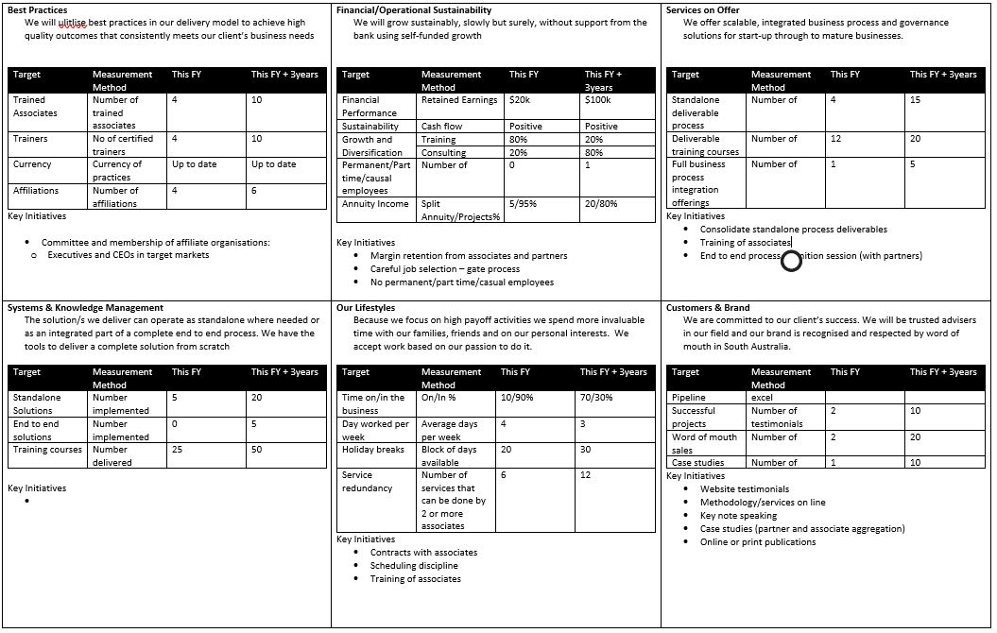
Example – A Balanced Scorecard
Notes:
Describe Verbally

Slide 8
Section 1 – Strategic Management
1.1.3 Are short-range objectives and goals regularly established and performance monitored with established Key Performance Indicators (KPIs)?
• Monthly, quarterly and/or annual objectives and goals should be established for short term review of status. These goals and objectives should be congruent with the longer range strategic goals and objectives.
• The short-range goals and objectives should be set by the people who have the responsibility of meeting them in collaboration with and the agreement of their managers. The goals and objectives should be specific and measurable, challenging yet obtainable; and can be financial, operational and non-operational in nature.
• Standardized tools, such as periodic company financial reports, resource loading and allocations, marketing reports, schedule reviews and technical reviews along with KPIs should be in place to allow monitoring performance in reaching short term goals and objectives. Feedback should be given frequently and corrective action should be taken as needed.
• Management should receive KPIs in a timely fashion based on an established reporting schedule.
• Responsibility for submitting the performance indicator report should be assigned and identified.
Notes:
So for short range objectives the balanced scorecard sets out short and long term goals – they were on the back of the page we looked at.
High level management is normally responsible for performance against the targets set and lower level managers responsible for providing the numbers in the timeframes required.
The balanced scorecard via a strategy on a page is a nice and succinct way to represent and communicate your strategy and the KPIs to achieve both short and long term goals

Slide 9
Section 1 – Strategic Management
1.1.4 Is there a quantified plan for company sustainability addressing ownership and management transition and is it understood by the stakeholders (i.e., succession planning)?
• The plan for transition of ownership and key management staff should be documented and reviewed by the company’s legal advisor. Multiple documents might comprise the plan. Those involved in the plan should be informed of the existence of the plan, the location of the written plan and how to implement the plan(s).
• Advancement opportunities should be documented and understood.
• Potential new management and key contributors should be identified.
• Guidelines/criteria should be established for the identification of potential new ownership.
• Basic training and accomplishment requirements should be documented as standard policy for advancement.
• A review of the transition plan should be done on a regular basis.
Notes:
Here we are talking about succession planning……
Legal advice is especially necessary when shareholding is involved and where the information needs to be kept on record by a national financial regulator – in Australia it’s the Australian Securities and Investment Commission (ASIC).
Its also prudent to understand what the owner’s intentions are for the business. For example when they are likely to retire……what are their plans for their own lifestyles ……and what will need to be done to fill their role and if they are planning to transfer or sell their shareholdings in the future? You could ear mark a current employee to fill the role and even allow them to “buy in”. In any case its good to know in advance to avoid any surprises and to plan forward. If you have a successor or understudy its good for them to be aware in advance so that a transition plan could be developed. You may also be thinking of floating on the stock exchange and of course then you will certainly need very specific legal advice.

Slide 10
Section 1 – Strategic Management
1.3.1 Does the integrator carry adequate insurance for the work or service that they perform? (i.e., general liability, errors and omissions/professional liability, property, casualty, theft, auto, workman’s compensation, computer systems, transportation of hardware/equipment, business interruption, and cybersecurity)
• To ensure the continuance of the integrator, in the event of a loss, there should be adequate insurance coverage in place.
• To ensure the integrator meets minimum insurance coverage requirements as specified in client contracts and as may be required by the region or location that the work is performed, there should be adequate insurance coverage in place.
• The integrator should have in place a standard approach to procuring insurance coverage, including general liability, errors and omissions/professional liability, property, casualty, theft, auto, workmen's compensation, computer systems, and hardware/equipment transportation, business interruption, and cybersecurity. Any exceptions to this standard approach should be approved by an authorized person.
• Additional insurance considerations may include Extra Expense Coverage, transit coverage, and potentially an umbrella coverage policy.
• At a minimum, annual reviews of the insurance coverage should be performed by an authorized person (with input from a knowledgeable resource familiar with the integrator’s operation and business).
• Please note that some countries, like China, require companies to purchase certain types of insurance coverage. Most countries, such the Netherlands and the United States, do not.
Notes:
This is all about insurance. The key here is to identify where your risks actually lie. Its sometimes better to workshop this with your current insurance provider. It’s in their interests to ensure that the right cover is in place to cover both themselves and more importantly you. There is also standard insurances that your customers may require that you have – in Australia and especially for design work you must adequate coverage for errors and omissions (this is also referred to as professional indemnity) and public liability insurance for say onsite works. And of course workers compensation for your employees that are in the workshop or out on site. You should also be considering what insurance you require of the same type from your contractors. If they design something unsafe - or cause an accident on site who carries the responsibility? In most cases it rolls up to you – as the prime and its reasonable for you to expect that your contractors are insured so that their liabilities flow down to them and their insurance company.

Slide 11
Section 1 – Strategic Management
1.3.3 Does the integrator carry sufficient errors and omissions / professional liability insurance to protect itself from devastating financial effects should an event occur?
• The integrator should have a blanket policy in place.
• The integrator should verify that the policy contains the appropriate definition of work matching the scope of the controls systems or other engineering work that is being performed.
• The integrator should verify that the policy limits meets minimum insurance coverage requirements as specified in client contracts or the law.
• Please note that some countries, like China, require companies to purchase certain types of insurance coverage. Most countries, such the Netherlands and the United States, do not.
Notes:
So this is very similar to the previous requirement but it does mention that it is also prudent to make sure that the insurance does specifically cover the engineered solutions you are delivering. Does it cover the development of control systems software? If you manufacture panels does it cover this? How about going out on a client site and doing some breakdown service and potentially changing some code whilst you’re out there? If the line stops and it’s a car manufacturing facility you might been in for a big bill for loss of production for example.

Slide 12
Section 1 – Strategic Management
1.3.4 Does the integrator have a documented disaster recovery and business continuity plan? Has it been tested?
• The integrator should have a business continuity manager in place to ensure the periodic review, ongoing management and governance of the process.
• The integrator should document what actions it will take and how it will continue business in the event of a disaster that partially or completely destroys their facilities.
• At a minimum, the plan should include the following business interruption plan: Direction and Control, Alerting and Warning, Facility Shutdown, and Evacuation.
• In addition, the plan should cover the following business continuation plan: Plant and Facilities, Equipment and Processing, Stock and Supplies, Administration, and Crisis Management.
• The plan should cover policies for internal and external communications. External parties may include media, clients and vendors.
• The integrator should consider business continuity insurance as a part of this plan.
• The plan should be simulated for effectiveness, adequacy and practicality.
• The plan should be reviewed on a periodic basis to evaluate its relevance and effectiveness based on the then ‘current’ and forecasted structure of the company, its financial strength and market conditions.
Notes:
Here we need to consider disaster recovery and if a disaster happens what is the plan to keep on operating? Is all of your company information on the cloud or backed up daily / weekly? Can your workforce work from home easily if required? If your office or manufacturing facility is affected by flood, fire, lack of power, even a lack of an internet connection or a combination thereof how do you continue operations? There are plenty of templates around to give you a head start but most importantly its best to try and simulate the event somehow and check to see whether your recovery and back up plans were effective. Don’t wait for it to happen and then check! From an auditors point of view its great to have a documented DRP and BCP but those best in class would have simulated the event and then changed their approach based on their learnings accordingly.

Slide 13
Section 2 Human Resource Management
2.1.7 Does the integrator have established job descriptions which are effectively communicated to the employee, kept up to date and available?
• Job descriptions should be established for each job classification which outlines each employee’s responsibilities and qualifications. This should include a description of all roles and/or job duties that this position may be required to perform.
• Job descriptions need to be defined and documented.
• Job descriptions should be aligned with the organizational chart.
• There should be a practice in place to effectively communicate the expectations of the job description to the employee at the time of hire, review and/or promotion. Employees should sign off on current job description.
• The job description should be kept up to date and available. This becomes an excellent reference for performance reviews and disputes over job responsibilities.
• Some countries, notably in the European Union, require providing the employee with a document describing the terms of his or her employment.
Notes:
We all know the value of having quality people in our organisations. We also know that it is really important that our people know the expectations of their role and that they agree and effectively sign off on starting or whenever the job role has changed. You can expect an auditor to randomly select an employee and for you to produce a job description for them. It would expected to be current, “signed” off in some way by the employee and accurately reflect their current duties. You might try to do the same exercise yourselves and see what you come up with? Also you might need to check whether there is a legislative requirement in your home country to provide terms of employment.

Slide 14
Section 2 Human Resource Management
2.1.9 Does the integrator have and enforce a policy regarding the use and/or possession of drugs, alcohol or other intoxicating substances?
• The integrator should have a comprehensive policy in place and signed off by all employees that they understand and will comply with the policy.
• The comprehensive policy should address all forms of intoxicating substances, both illegal and legal. Any drug testing policy should be in a written format and be reviewed by legal counsel for compliance with country, state, province and local regulations.
• The policy should address requirements for employees working at other locations, clients, countries, etc.
• The integrator should have a policy that addresses drug testing requirements of employees.
Notes:
Here is another clear policy that needs to be in place and clearly communicated to a new employee and re-communicated throughout employment. Each state or country will have different legal requirements with respect to drugs and alcohol and in particular testing by you the employer or by your clients. Local business associations are good place to seek local requirements in this regard and often have templated policies that you can use for free or as part of your membership. Either way it needs to comply with the law and will need to be checked in some way shape or form to that end. Its very important that any drug and alcohol policy is understood and signed off by employees since non-compliance is sometimes considered to a first strike instantly dismissible offence.

Slide 15
Section 2 Human Resource Management
2.2.1 Does the integrator have a standard policy and procedures for recruiting, interviewing and selecting new employees? Has it been reviewed for compliance with all applicable regulations? Are recently hired employees asked for suggestions to improve the process?
• A standard policy including a diversity strategy for recruiting employees should be in place that will aid in expediting the process of filling a position.
• The policy should be periodically reviewed for compliance with regulations by the appropriate counsel.
• New hires should be asked for suggestions on improving the process.
• The integrator should use proven interviewing guidelines, selection tools and practices, (e.g., behavioural interviewing, technical competency testing, etc.) in a consistent manner. This process should be reviewed regularly to ensure its effectiveness.
• The integrator should use formal job descriptions as a part of the recruiting process.
• The integrator should provide training to those who are involved in the recruiting process regarding what is permitted, what is not permitted, and employee regulations.
• Some countries, such as Colombia, impose additional requirements, such as a mandatory medical examination upon hiring.
Notes:
How do recruit your people? Do you do it internally or send the job off to recruiting firm and they take a cut? Who can hire and who can fire? How do you get permission to hire a permanent employee or a contractor? The way in which companies recruit can vary widely but in any case it’s a good idea (again) to write down how you do it as opposed how you plan to do it.
Its pretty obvious that when you recruit - your applicants are going to want to see a description of the role, the proposed salary (even if its just a range) and what the responsibilities are.
There might be some level of training that is required for those that are involved in the recruiting process. This includes some things that you should ask applicants, things they need to prove (even via a practical demonstration) and importantly inappropriate personal questions that you should avoid asking.
Some company’s have internal requirements for psychometric testing, initial medicals to check for pre existing conditions or even police checks for positions that relate to the handling of finances. Its about where the risks lie and what impact they have if these checks are not carried out and again in some countries or states will have their own legal requirements – you’ll need to check

Slide 16
Section 2 Human Resource Management
2.2.6 Is there a formal orientation process for new employees? Are there written descriptions of benefits, applicable employee programs, employee manual and a list of people to contact for assistance in different areas? Are new employees given formal introductions to the integrator’s organizational structure and the integrator’s list of policies and procedures? Do new employees “sign off” upon receipt of the employee manual as having read and understood it?
• Formal orientation process should be in place for new employees to understand the company structure and policies. This should include a process in which new employees meet various team members, are provided an overview of company vision, mission statement and core values. o Policies that should be reviewed with the new employee include: ▪ Employment policies
√ Standard operating procedures √ Attendance √ Expense reports √ Use of standards and templates
√ Quality requirements √ Use and adherence of best practices
√ Client Nondisclosure Agreement (NDAs) or client specific requirements
√ Safety √ Etc.
Employee and orientation supervisor should sign off that relevant requirements have been reviewed (i.e., orientation checklist)
A formal “orientation package” including the above list should be in place to familiarize the employee with the company
Notes:
The level and formality of orientation carried out for new employees can also vary widely from one company to another. It’s a good idea to have a “buddy” assigned so that new employees are introduced to their most relevant colleagues in the first instance and ……..some manner in which they are informed about the company culture, its vision and targets and the way in which that employee will assist in the realisation of that strategy.
Some other things that might be a good idea to talk through are shown with green ticks next to them in the slide and its also a good idea to develop some kind of checklist for the buddy (or orientation supervisor) and the new employee to go through so that we are assured we have covered off on even the most basics of orientation – its also good for an auditor to see these orientations signed off by both the supervisor and new employee.

Slide 17
Section 2 Human Resource Management
2.3.1 Does the integrator have a standardized and documented performance management program for all employees?
• A performance management program should include:
Relationships to company and/or higher level strategies
Current job descriptions, roles and responsibilities (i.e. Key Responsibility Area (KRAs))
Current job competency levels and targets focusing on employee hard and soft skills.
A review and evaluation of past results
A mechanism to incorporate feedback on current performance based on accomplishment of pre-agreed goals and objectives which are objective and measurable
A mechanism that details and documents the requirements, tasks, and results for an employee to achieve their professional development objectives. A process to establish agreed upon future goals, objectives and professional development plan. These goals should be specific, measurable, achievable, realistic and timely (i.e. SMART goals).
• The integrator should have specific metrics in place to monitor the effectiveness of the performance management program. These metrics should be reviewed on a regular basis.
• Examples of metrics may include:
Percent of goals reached
Percent improved each year
Notes:
Performance Management……..Firstly whist it’s a good idea to have a performance management system and that employees are checked at least once a year versus established targets, the performance management meeting and its content should not be a surprise for an employee.
If it is – it generally means that there are low levels of informal appraisal and feedback happening. Employees should be regularly steered in the right direction and equally congratulated on a job well done.
A formalised performance management meeting whether it addresses shortcomings or good performance should never be a surprise. Recording of such meetings is important because an increase in salary level might be attached to it or…… even a documented trail to reduce the risk of an employee coming back with an unfair dismissal claim.
Its up to you whether you make this an annual event – with a lead up at the six month period or any other timeframe – its important that it is well known and communicated to employees.
There is mention in the standard about setting SMART goals as described in this slide. It is also a good time to talk about development and training – training goals could be discussed at the very same juncture in time.
There are some example metrics mentioned in this clause as well.
We will now move onto the clauses regarding training and professional development.

Slide 18
Section 2 Human Resource Management
Training and Professional Development
2.4 The system integration business is heavily dependent on the knowledge base of the staff. A focus on constant acquisition of knowledge and skills are key to remaining competitive in today’s marketplace.
This section addresses the integrator’s position on employee development as related to technical training, soft skills training, career goals, and job satisfaction. The integrator must be able to retain a highly competent staff. In order to accomplish this, the integrator must work on developing its most important internal asset: the employees.
The integrator’s skills and training requirements should be supported by a documented training program. The combination of this training and skills development can be the basis for a career development plan for the employees.
Notes:
Whilst the statement on the slide is not scoreable per se it is however worth reading out aloud……
Read above slide verbatim……
In many businesses that I have been either an employee of or as a consultant I am constantly reminded that people appreciate a conversation around their current skills, where they could be developed in the future and how they align to the strategic direction of the company – therefore of mutual benefit to both the employee and the organisation. In short don’t miss this opportunity – it’s a common reason for people not being happy at work and even for one major cause for leaving – lack of professional development.

Slide 19
Section 2 Human Resource Management
2.4.8 Does the integrator have a documented training program on the integrator’s internal methodologies, practices, procedures and tools? Does the program include documented employee assessment and record keeping?
• The general requirements of a documented training program are discussed in the narrative of section 2.4 above.
• Key areas of internal methodologies training should include:
Use and compliance with the Project Management (Project Managers) and System Development Lifecycle (Engineers)
Use and compliance with Configuration Management (Engineers)
Use and compliance with business systems and processes (All staff)
Use and compliance with reuse program, standards for developing components, a library of standard components, and standard application and a style guide for custom applications (Engineers)
Notes:
So what we are saying here is that training around some of the requirements around some of the most important best practice standards are considered to be of high enough importance that they should form part of a documented training program.
By way of example - I have added in some of the roles (in green) that would potentially align to the training of the internal methodologies noted on the slide
We are also talking here about how we assess their competency. There are many ways to produce evidence including induction videos with pass/fail questionnaires at the end, on the job performance appraisals and internal audits to check whether the system requirements have been adhered to.

Slide 20
Section 2 Human Resource Management
2.4.9 Does the integrator have a documented training program that addresses the soft skills required of employees? Does the program include documented employee assessment and record keeping?
• The general requirements of a documented training program are discussed in the narrative of section 2.4 above.
• Soft skills typically refer to a combination of personal qualities and interpersonal skills.
• Many soft skills by their nature tend not to be job or domain specific and tend to complement hard skills.
• Key areas of soft skills training program might include:
Effective Communication
Interviewing
Delegating
Team building
Personal effectiveness skills
Employee conduct
• The integrator should have a formal method of evaluating how effective training has been.
Notes:
Here we are talking about the soft skills required. As mentioned in the slide…. soft skills refer to a combination of personal qualities including interpersonal skills.
For example:
Project managers should have the ability to effectively communicate with customers and build effective and high performing teams
Sales Managers need to develop a repour and an ongoing trusting relationship with clients; and
Each employee needs to effectively communicate with all parts of the business and display the culture that company values.
Evaluation of soft skills in the main is a subjective task - but is ultimately about how an individual leverages their soft skills to produce desired outcomes – like trust and ongoing relationships with customers for example and project teams whose performance regularly exceed the sum of their parts.

Slide 21
Section 2 Human Resource Management
2.4.10 Does the integrator have a documented training program that addresses the hard skills required of technical people? Does the program include documented employee assessment and record keeping?
• The general requirements of a documented training program are discussed in the narrative of section 2.4 above.
• Hard skills refer to the technical or domain specific skills necessary to perform a given job.
• Hard skills training should be timed to allow trainee to apply the newly trained skills on a project.
• Key areas of hard skills training program should include:
Job specific skills required to perform at a given level
Industry standard requirements
Client processes
Specific technology
• The integrator should leverage external and internal sources to provide/perform training.
Internal cross training and mentoring
Leverage vendors and other external sources to provide training on necessary hard skills
Notes:
Here we are talking about the hard skills required. As mentioned in the slide…..hard skills refer to the technical or domain specific skills necessary to perform a given job.
For example:
Project Managers qualified or certified in best practice project management methodologies
Sales and Account Managers – formal sales training
Engineers – OJT or formal training on developing control systems software on platforms like Siemens, Rockwell Schneider etc…
Project teams may be required to be inducted into the way that a client develops its solutions as well
Some companies have graduate or new engineer training using automated mini-factories as a training base or send them to vocational education training providers who provide these services as part of a diploma or at certificate level.
Evaluation of hard skills is in the main an objective exercise. For example, a formal and documented review by a senior engineer as part of OJT or the gaining of a specific certificate or diploma as evidence.

Slide 22
Section 2 Human Resource Management
2.4.11 Does the integrator have a documented training program that addresses the skills required of management? Does the program include documented manager assessment and record keeping?
• The general requirements of a documented training program are discussed in the narrative of section 2.4 above.
• Required management skills should include both hard and soft skills.
• It is suggested that key areas of management skills training program include:
Planning, prioritizing and organizing tasks and activities
Motivation and leadership
Communication skills; questioning and active listening; building trust, empathy, and mutual understanding
Performance appraisals planning and conducting
Performance counselling, handling grievances, instituting disciplinary actions
Coaching, mentoring and developing others
Delegation
Managing conflicts
Effective use of planning and reporting systems
Financial and commercial understanding
Planning and running meetings
Quality awareness and managing, according to quality standards and procedures
Employment and HR policy awareness and managing, according to policies
Client care and client service management
Emotional Intelligence
Employment-related laws and regulations
Notes:
Here we are talking about a combination of hard and soft skills required of management in particular.
Formal management courses at degree, diploma and certificate level have in the main…… elements of the all of the smaller bullet points in the slide we are looking at right now
Similar to hard skills they can be evidenced by the documented gaining or previous completion of a specific degree, certificate or diploma

Slide 23
Section 2 Human Resource Management
2.6.2 Does senior management hold periodic meetings to review the state of the integrator and solicit input from all employees?
• Business practices must be in place to allow for timely and efficient communication among management personnel and between management and staff.
• Both formal and informal lines of open communication should be encouraged.
• Issues to address may include status of integrator relative to strategic plan and critical issues affecting company direction.
• Employee concerns and questions should be heard.
• Meetings should be formal with supporting evidence.
• Post meeting follow-up sessions should be held to address open issues.
Notes:
Its good practice to facilitate communications between management and employees. Most integrators have a very pragmatic way of achieving and evidencing this. Once a month they get together and senior management present on the “state of the nation” sharing high level sales results, ………..congratulating high performers, ………………….new initiatives, ………………the upcoming pipeline of work, ……………safety moments and any other general business. Combined with a few refreshments and maybe a BBQ this becomes an effective way of achieving a high level of compliance against this requirement. Its even better if you can video the event and then store the presentation on the company intranet site to allow those not present to review the presentation in their own time.
It also allows any employee concerns to be voiced in front of the group or a one to one conversation over a drink in a non-threatening environment.
Depending on your size you can handle this in many other ways to similar effect but in any case it’s a worthwhile way to keep all employees updated on the current state of play.

Slide 24
Section 2 Human Resource Management
2.6.3 Are documented policies, procedures, and training provided to facilitate effective internal and external meetings?
• Agendas and objectives should be set, timing respected and everyone attending participates and contributes.
• There should be training on how to conduct meetings according to the guidelines that the integrator has established.
• There should be documented evidence that meetings are well structured and utilize agendas, objectives and minutes.
• Problem-solving members should be active participants to ensure valuable contributions.
• There should be assigned tasks such as facilitator, time keeper and note taker.
Notes:
Internal and External meetings need to be structured
A lack of structure wastes people’s time and you are unlikely to receive the correct amount of attention if the participants are not properly engaged.
It is especially important to ensure that external meetings are well conducted. Sometimes the client will base their impression of your company’s capabilities on how well the meeting was organised and run

Slide 25
Section 2 Human Resource Management
2.8.2 Does the integrator provide ongoing safety training?
• As new safety policies and procedures are introduced, employees should be informed about changes.
• It is suggested that required employees should attend an annual retraining to reintroduce OSHA or equivalent national/regional/local regulations along with company safety policies and procedures.
• All training and safety reviews should be documented and be kept on file using a form showing the date, subject matter covered, and employee signature.
• Integrator should consider client requirements and client issued training as part of assessment and record keeping. Project specific safety requirements should be considered.
Notes:
I’m now reading verbatim from the introduction to the Safety section 2.4
With employees being an integrator’s most valuable assets, protecting them and the environment is critical to sustaining the business. Ensuring that employees are trained in safety will not only protect the employee but will also protect the integrator from unforeseen costs due to insurance claims, loss of a critical resource or worse yet court costs and judgements.
Its normal practice for safety to be part of an initial induction into a company. A general induction will identify the hazards within the workplace and the controls in place to lessen the risk of an employee being hurt.
But we also know that many integrators work on high energy systems such as high voltage and even hydraulics. We also work on machines including robots whose functionality needs testing. We work in places where sewage and toxic chemicals are present such as waste water treatment plants and refineries
.
Therefore our employees can be subjected to high risk environments each and every day.
During commissioning there is a potential for systems to fail in unlikely ways. Your systems and processes of work need to take into account these hazards and importantly your people need to be trained either internally or externally to identify and control such hazards
You will need to provide evidence of how safety is trained within your workplace, how changes are communicated and how changes are checked for understanding. For working on a client site you might have a Job Safety Environmental Analysis (JSEA) that would need to be completed or a toolbox meeting record that shows that any new safety risks for example are being discussed by an installation and commissioning team.
Some clients also require contractors to undergo a site induction before stating on site and comply to these requirements during the life of any onsite work. Documented evidence of these will be helpful for an auditor to see.

Slide 26
Section 2 Human Resource Management
2.8.4 Does the integrator perform in-house safety inspections and audits?
• It is suggested that inspections should be scheduled for times when inspectors will have the best opportunity to see operations and work practices with minimal interruption.
• Applicable regulations and requirements of the individual projects and clients should determine a suggested guide for the inspection schedule.
• An inspection form should be filled out stating information such as unsafe conditions and deviations from accepted practices found during the inspection. This form should be kept on file for use during later inspections.
• Every inspection should be documented in a clearly written report furnished by the inspector. This report should include the name of the department or area inspected, date and time of inspection, name and title of those performing inspection. This report should elaborate information on the inspection form in detail stating unsatisfactory conditions observed during the inspection along with any conditions that carry over or are repeated from previous inspections. Generally, inspection reports are sent to the head of the department or area where the inspection was made. Copies should be given to executive
management and the management to whom the department head reports.
• Some countries, such as the Netherlands, require companies to hire a third-party “certified working conditions service” to advise them on health and safety issues.
Notes:
For our own in-house safety its good practice to perform safety inspections. There are many templates on line that you can adapt to your purposes. Make sure however that what you are inspecting relates to any applicable regulations and requirements. Electrical safety, existence of fire extinguishers, exit lighting and clear paths of egress are some examples that immediately come to mind.
In general – make them regular, train more than one person to do them, make sure you follow up on any deviations and save the results where they can be reviewed and followed up if necessary.
If you are already compliant to a standard like ISO 45001 for example an auditor would expect to see strong compliance against this part of the standard.

Slide 27
What’s in the Next Webinar?
CSIA BP&B Webinar Module #2:
Section 3 – Marketing, Business Development, Sales and Opportunity Management
Section 4 – Financial Management
Notes:
Well that’s all for this webinar. In the next webinar we will be looking at two very important parts of your business. The front end (marketing, BD, Sales and Opportunity Management and how the money comes in and out of the door, namely Financial Management

Slide 28
Improvement Suggestions? Contact tom@latsa.com.au Thanks for listening in…. Have a great day!
Notes:
Again if you have any suggestions to improve these webinars please drop me a line
Thanks for listening and I hope you will join me next time for Module 2
Thanks and have a great day!

